Slide 1
CULTURAL CENTER-PLOČAŠ- UZDOLJE

Slide 2
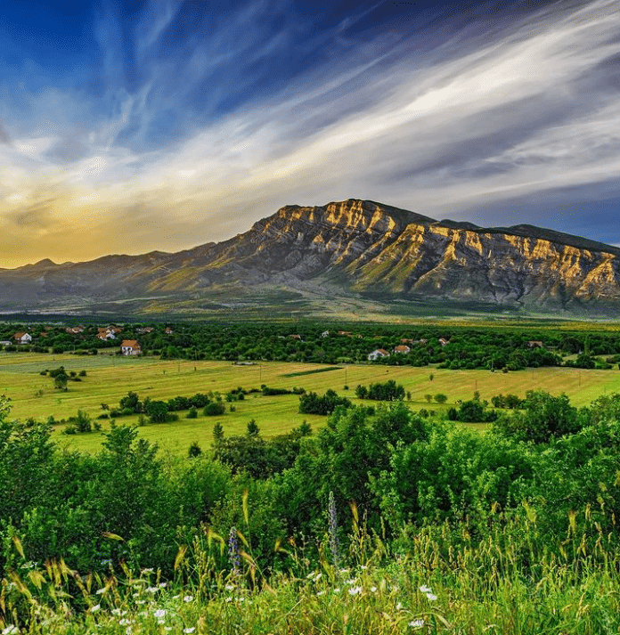
Deeply convinced that there are still many of us who remember with longing and nostalgia the times of our childhood and early youth, spent in this beautiful, colorful and tame valley, a valley narrowed on one side by the Promina mountain and on the other side by the Dinara mountain massif.
We rembember the days spent playing, rejoicing, the moment of enrollment in primary school, the moment of going to the city of Knin to the upper grades of primary school, enrollment in Grammar school, enrollment in trade school, some unfortuantely outside the country’s borders.

Slide 3
Location

Slide 4
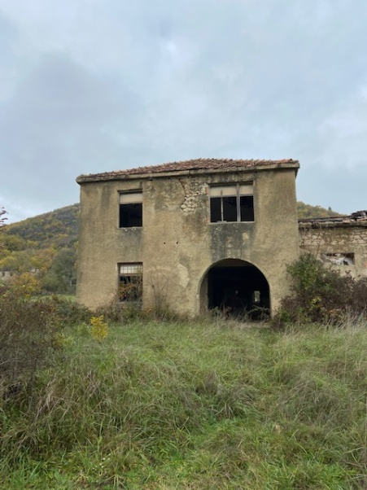
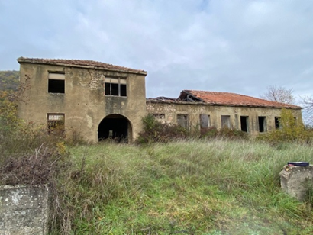
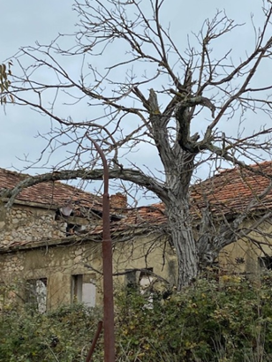
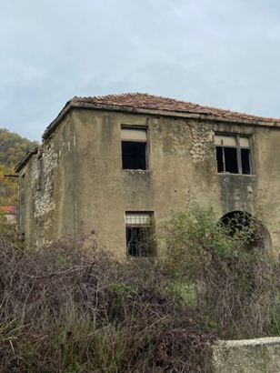
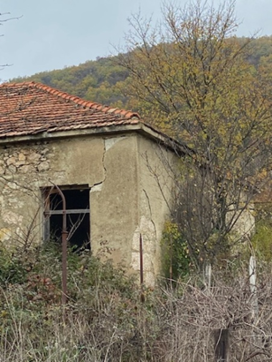
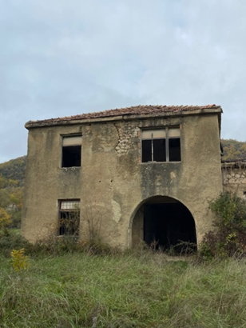
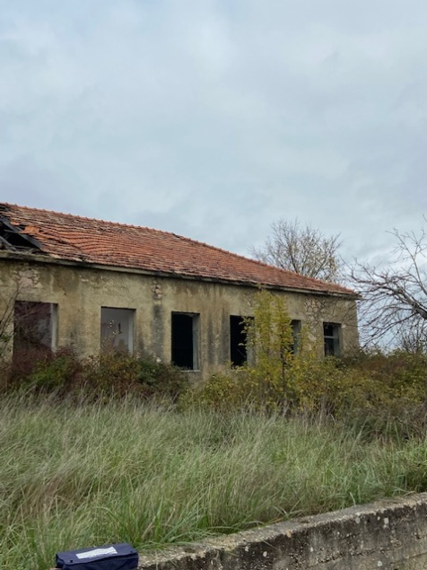
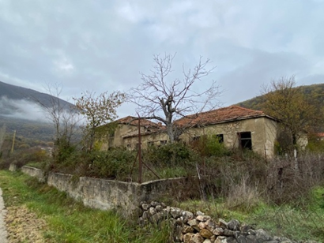
We spent many of these moments next to our school building, which was the focal point of gathering, and along the way we also remembered the work and contribution of our parents who built it for us. .
With these memories, we set out with the ambitious idea of renovating the school building. However, due to weather and other influences, the condition of the building is very bad - so much so that the idea of restoring the building had to be abandoned.

Slide 5
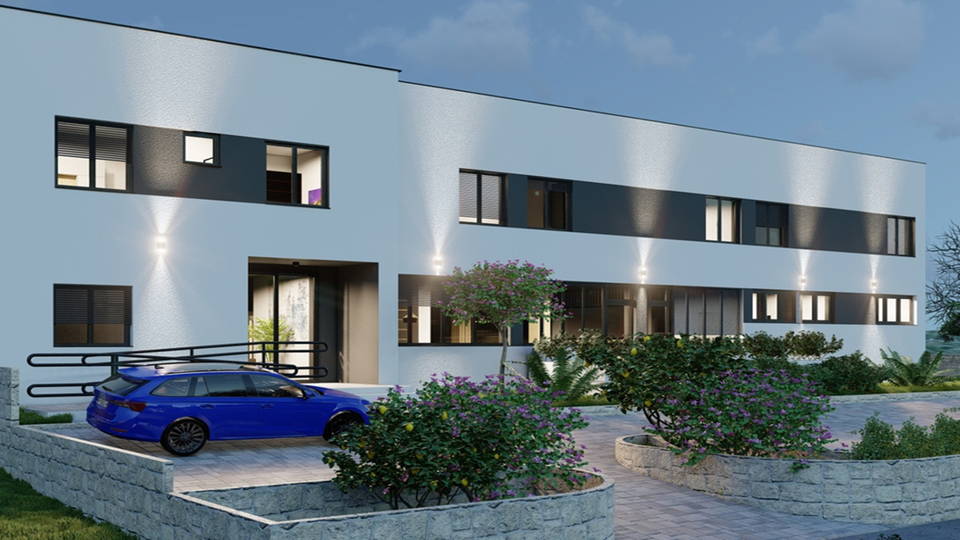
We have decided to propose the construction of a new building that would fulfill our wishes and needs, in further economic, cultural and any other development and improvement.
In the realization of these ideas, we are counting on YOUR help, and therefore we have prepared this display/presentation.

Slide 6
Programming – design guidelines
For the purposes of this community in the Municipality of Biskupija, it is necessary to provide a space in which activities in the direction of all-round development of the community living in this area would take place, as well as a space that would have a multifunctional application.
Cultural Center "Pločaš" would ultimately have three basic thematic categories:
1. „Vuk’s camp - camp of literacy“- The program includes a seven-day camp for children and young people with educational workshops on the topic of literacy development from cuneiform to today's alphabet, with sports workshops that include horse riding in the equestrian club and about 20 outdoor and indoor sports, with excursions (Krka National Park, nature park Dinara, Krka, Krupa, Dragović, Sv. Nedjelja, Lazarica monasteries), with creative and entertaining workshops, all programs are led by an expert team.
2. „The miraculous power of color - art colony" - The program includes a five-day stay in the Cultural Center with organized painting workshops at the spring of Kosovčica, on the Krka River, on the Skradinski Buk, on the Knin Fortress, and visits to the sights of Dalmatia.
3. „Jači do cilja- Team building" program includes a two-day unique opportunity for team members to engage in fun and challenging experiences through which teamwork will be promoted and communication improved. Teamwork is the engine that drives most companies and is necessary for a business to succeed.
In addition to the basic categories/contents of the Cultural Center "Pločaš", there are also contents that are vital for the entire community:
✓ multipurpose space within the ground floor where activities, learning, presentation of achievements in the work of the local community, entertainment, distribution of meals, etc. with accompanying contents would take place / for approx. 40 people/;
✓ a space where hot meals for breakfast– lunch would be prepared, etc. with accompanying facilities;
✓ a management area that would occasionally serve residents to provide health care;
✓ accommodation space on the first floor with accompanying facilities.

Slide 7
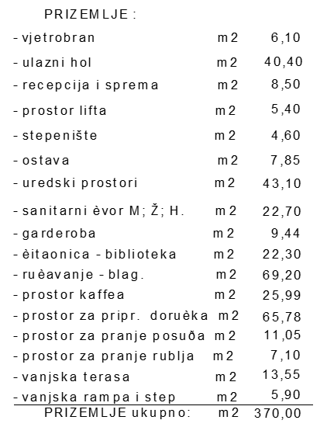
GROUND FLOOR
-windscreen
-entrance hall
-reception and storage
-elevator space
-staircase
-pantry
-office premises
-sanitary facilities
-wardrobe
-reading room-library
-dining room
-café area
-breakfast preparation area
-dishwashing area
-laundry room
-outdoor terrace
-outside ramp and staircase
GROUND FLOOR total:

Slide 8
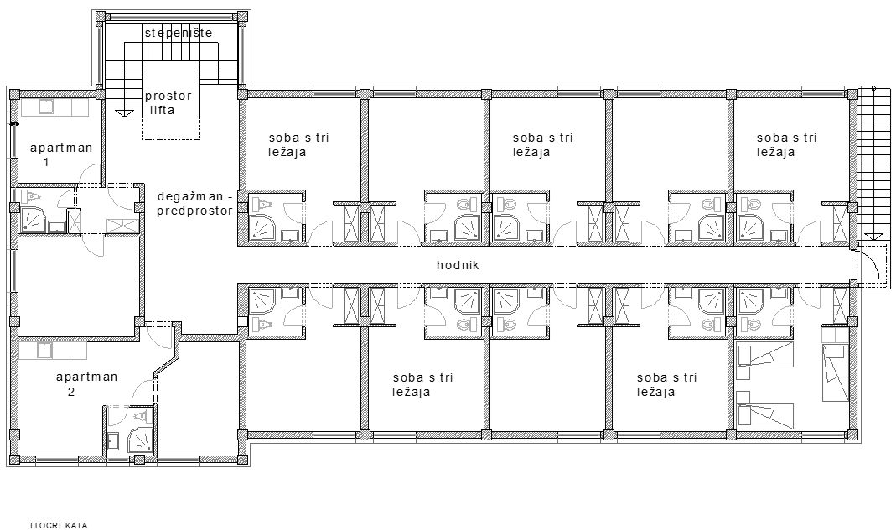
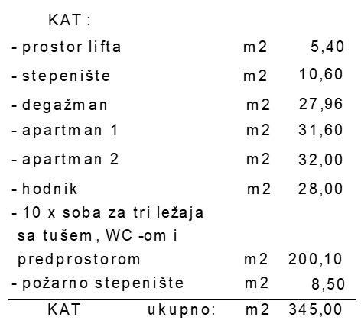
FIRST FLOOR
-elevator space -corridor
-staircase -10x triple rooms with shower, toilet and an entrence hall
-Enterance corridor -fire escape
-apartment number 1
-apartment number 2 FIRST FLOOR total:

Slide 9
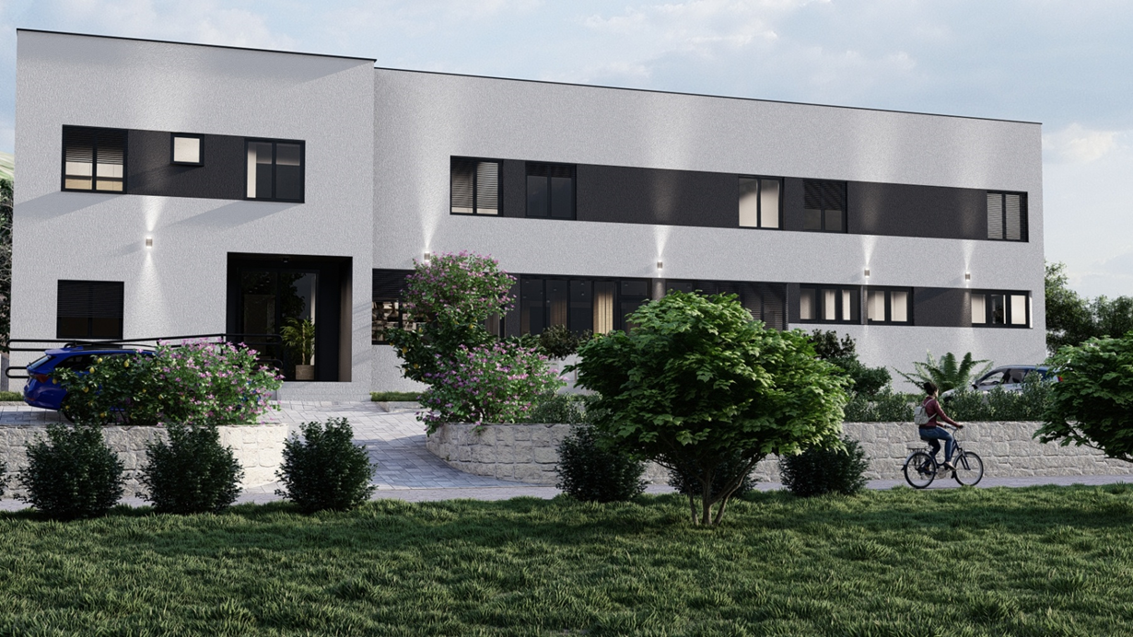
POGLED SA SUSJEDNE JUŽNE PARCELE NA JUGO-ISTOČNO PROČELJE
VIEW FROM THE ADJACENT PARCEL TO THE SOUTH-EASTERN FACADE

Slide 10
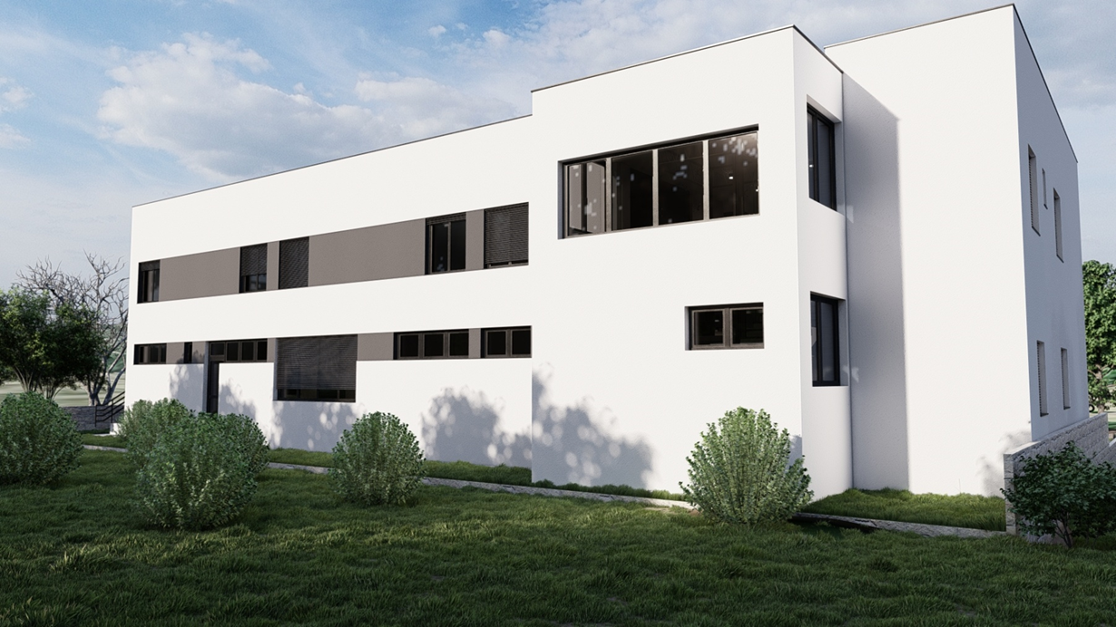
VIEW OF THE NORTH-WESTERN FACADE

Slide 11
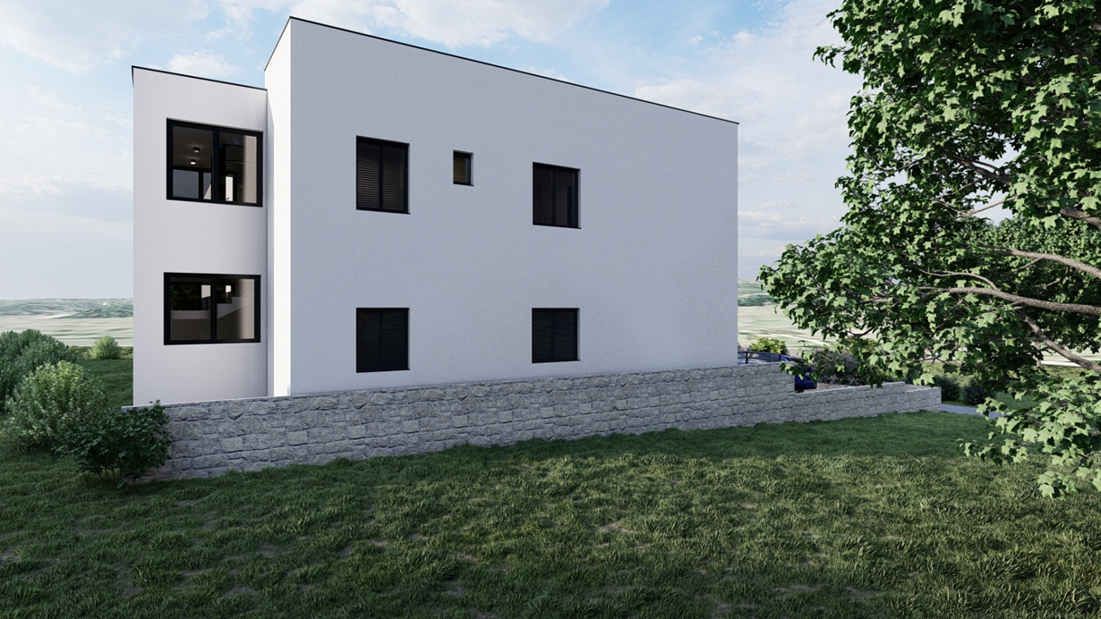
VIEW OF THE SOUTH-WESTERN FACADE

Slide 12
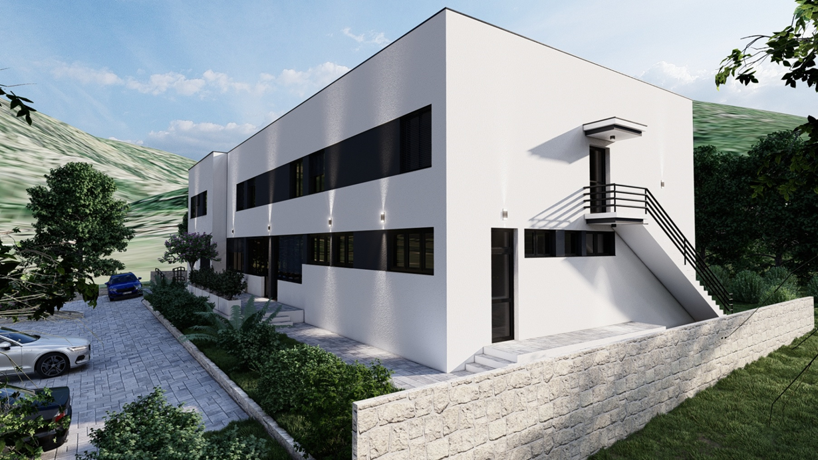
VIEW OF THE SOUTH-EASTERN FACADE

Slide 13
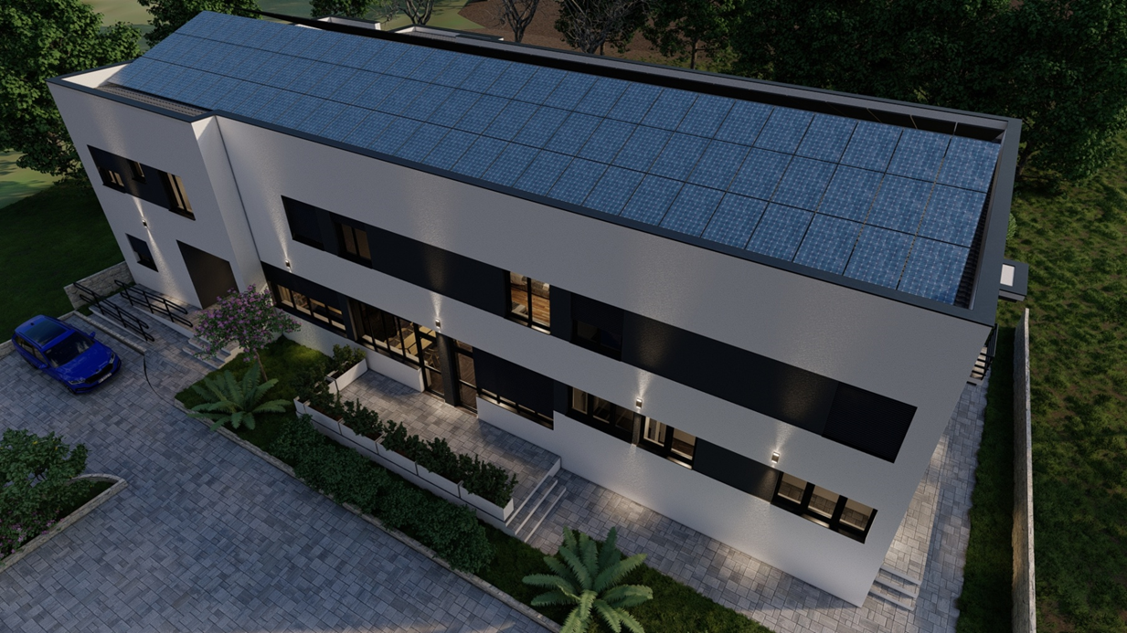
AERIAL VIEW OF THE SOUTH-EASTERN AND NORTH-EASTERN FACADE

Slide 14
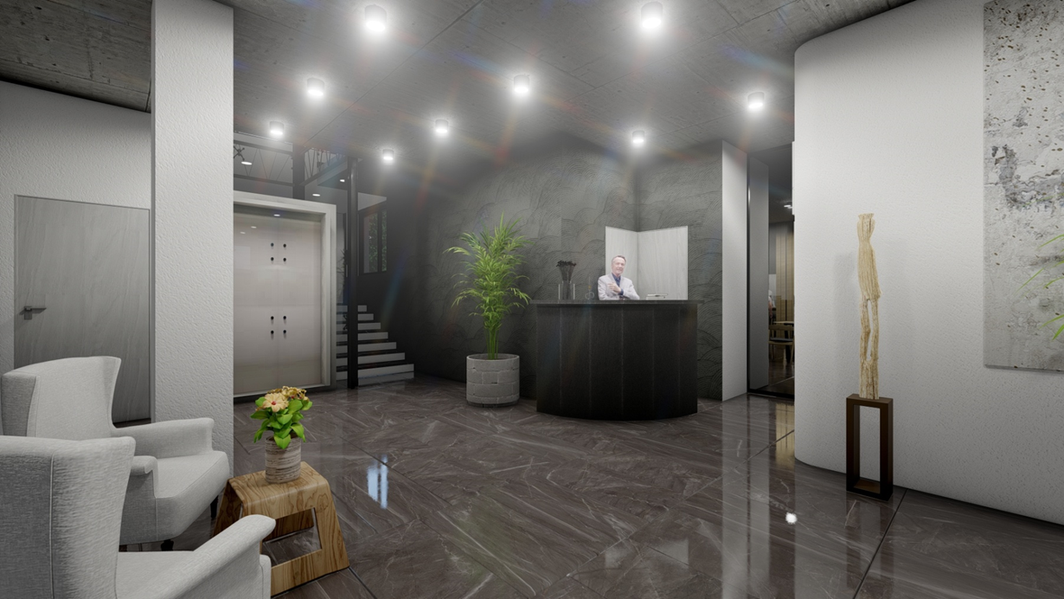
ENTRENCE HALL
VIEW OF THE ELEVATOR, STAIRCASE, RECEPTION, MAIN ENTRANCE AND ENTRANCE TO THE DINING AREA

Slide 15
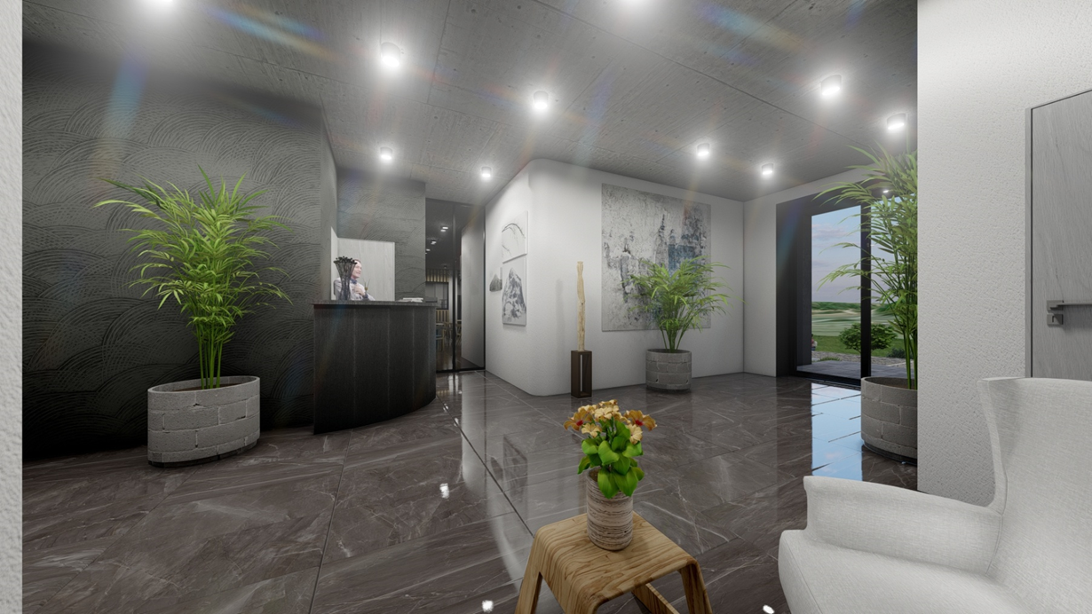
ENTERANCE HALL
VIEW OF THE RECEPTION, MAIN ENTRANCE AND ENTRANCE TO THE DINING AREA

Slide 16
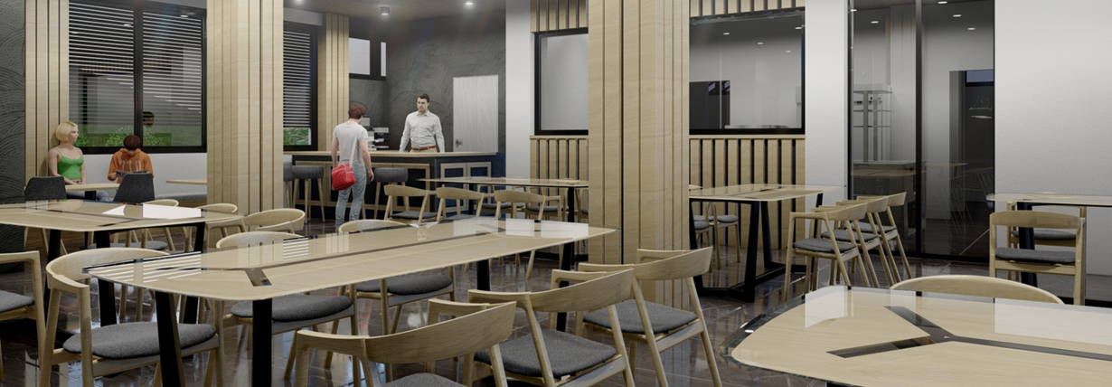
MULTIPURPOSE OPEN SPACE
VIEW OF THE AREA FOR PREPARING AND SERVING MEALS, CAFE
/ THE SPACE CAN BE DIVIDED WITH MOVABLE PARTITIONS INTO SMALLER SPACE FOR SMALLER GROUPS/

Slide 17
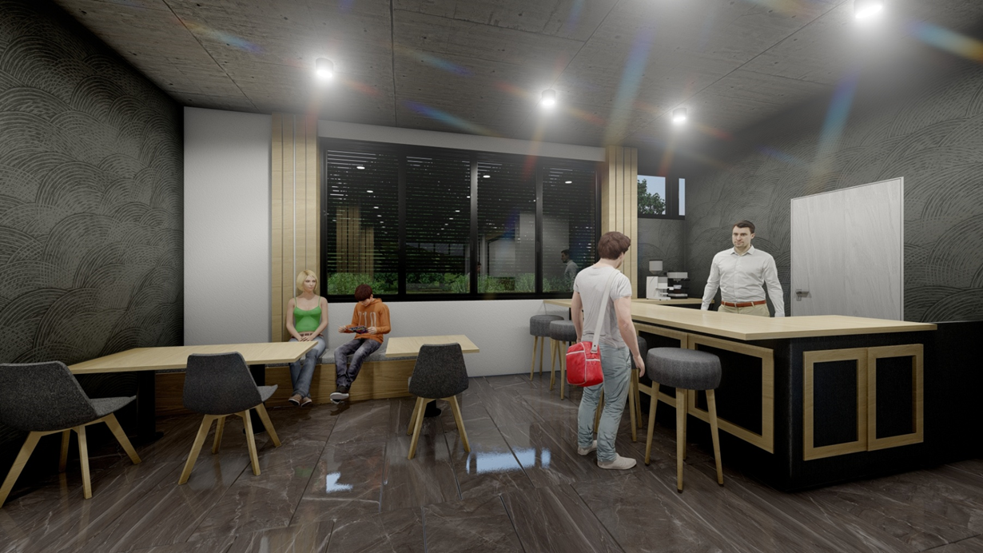
VIEW OF THE CAFÉ AREA

Slide 18
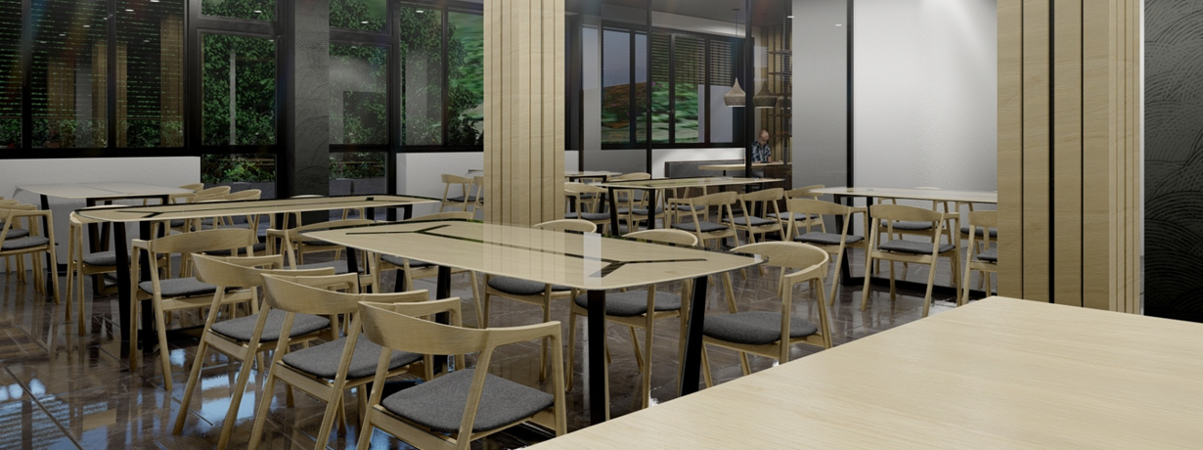
VIEW OF THE MEAL SERVING AREA AND THE READING AREA

Slide 19
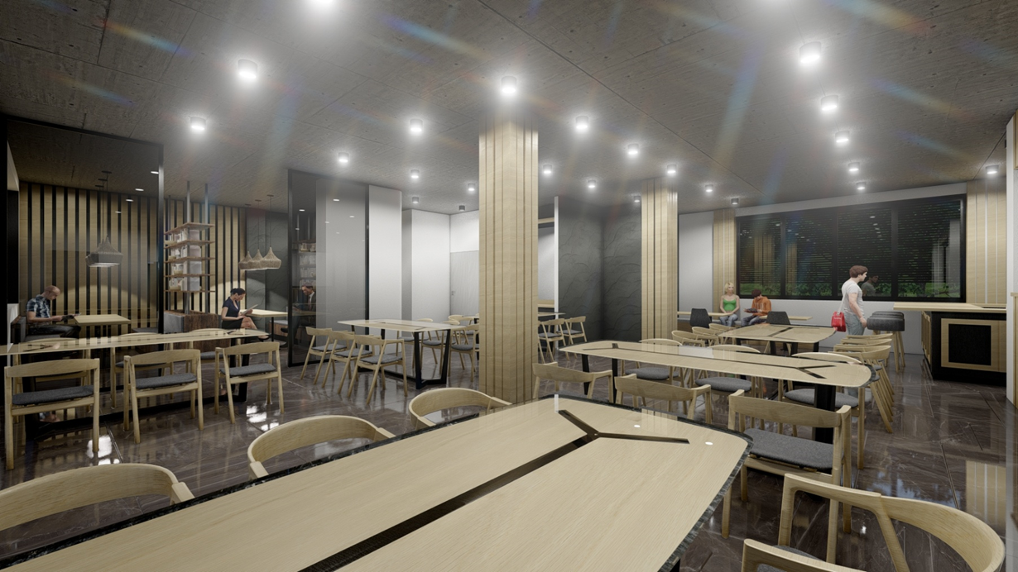
VIEW OF THE READING ROOM, WARDROBE, CAFÉ ....

Slide 20
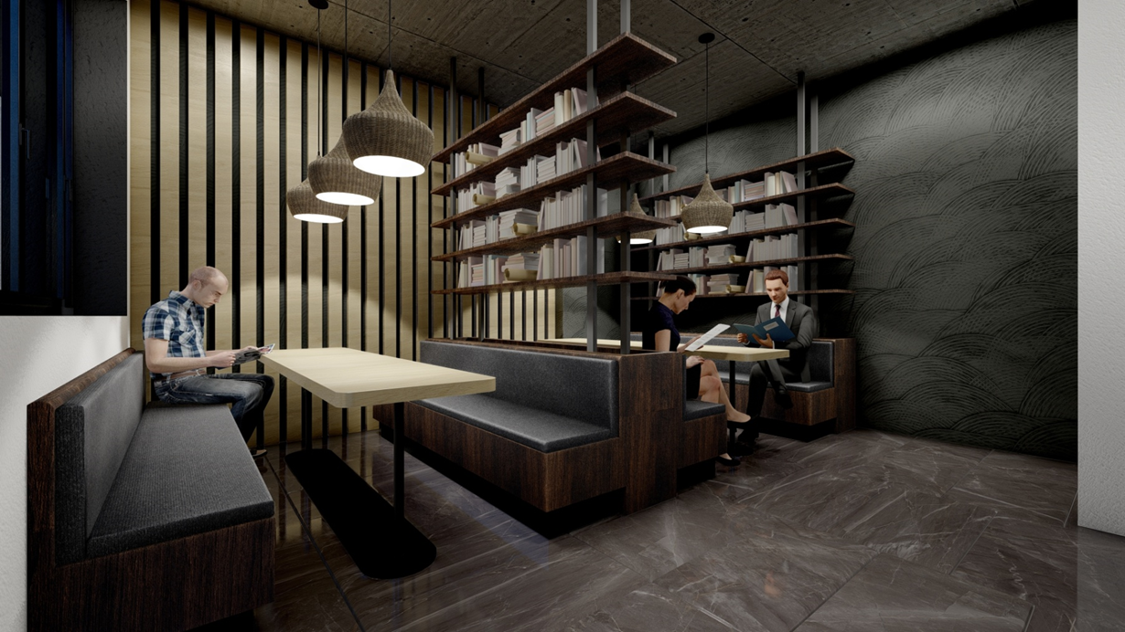
READING ROOM AREA

Slide 21
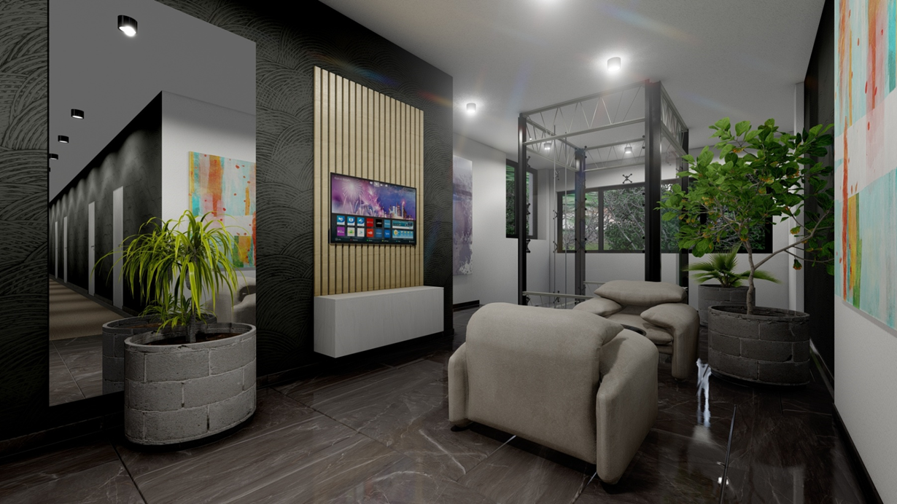
VIEW OF THE ELEVATOR AND STAIRCASE FROM THE FLOOR HALL

Slide 22
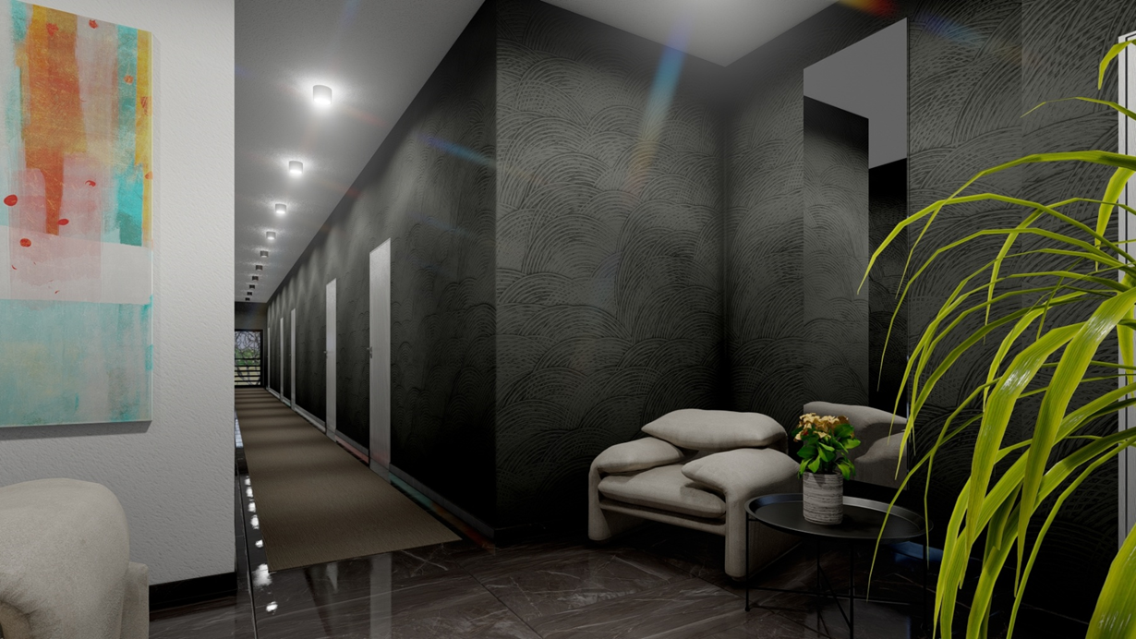
VIEW FROM THE FLOOR HALL TO THE CORRIDOR AND ENTRANCES TO THE TRIPLE ROOMS WITH BATHROOMS

Slide 23
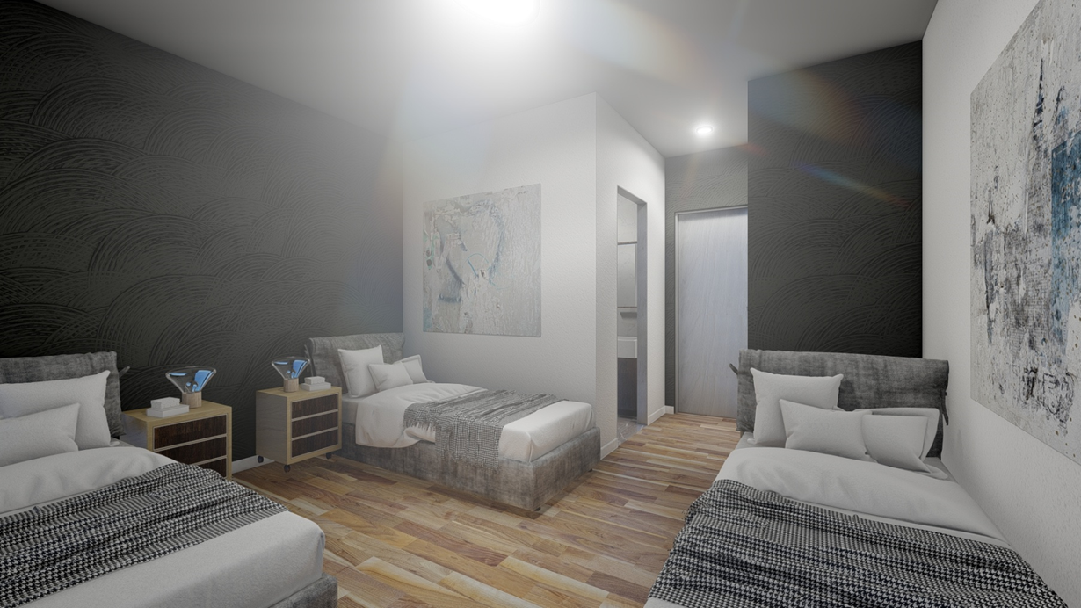
VIEW FROM THE TRIPLE ROOM TOWARDS THE BATHROOM AND THE HALLWAY WITH A WARDROBE

Slide 24
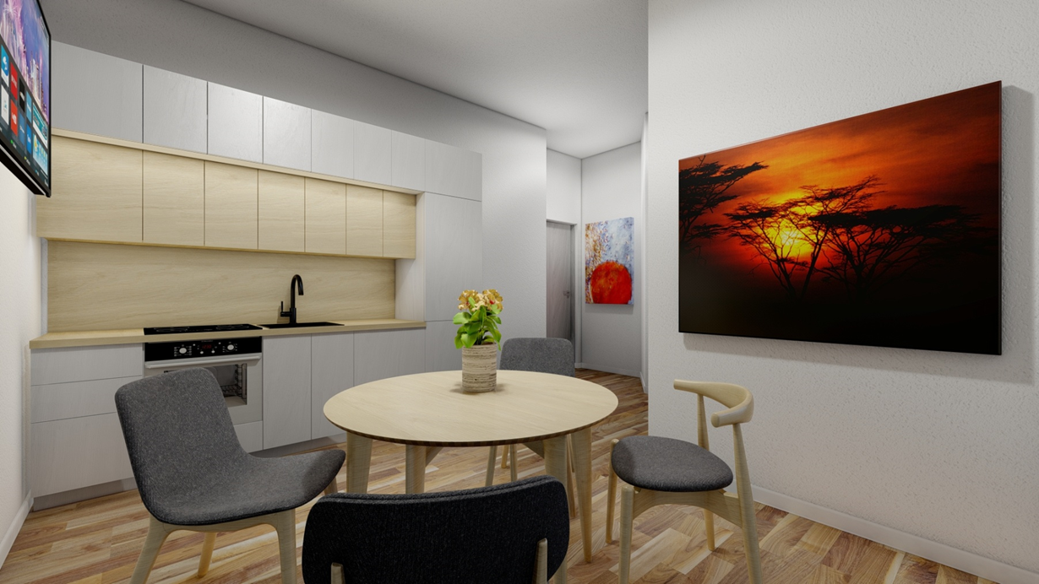
THE UPSTAIRS APARTMENT KITCHEN AND LIVING ROOM

Slide 25
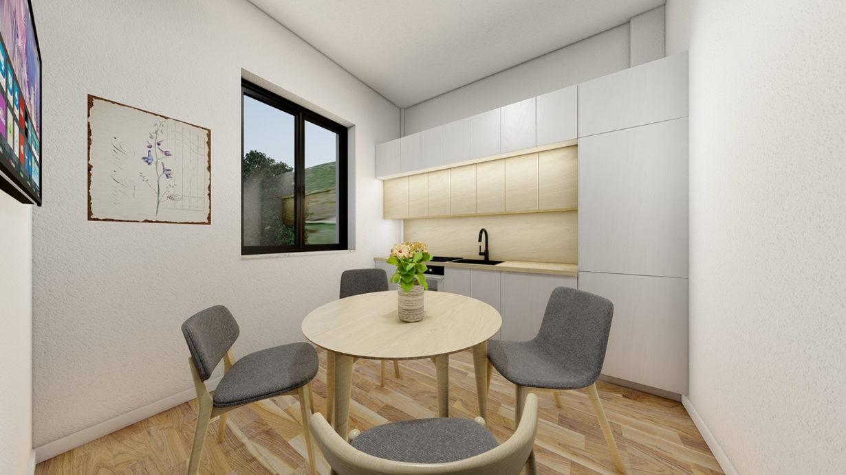
THE UPSTAIRS APARTMENT KITCHEN AND LIVING ROOM

Slide 26
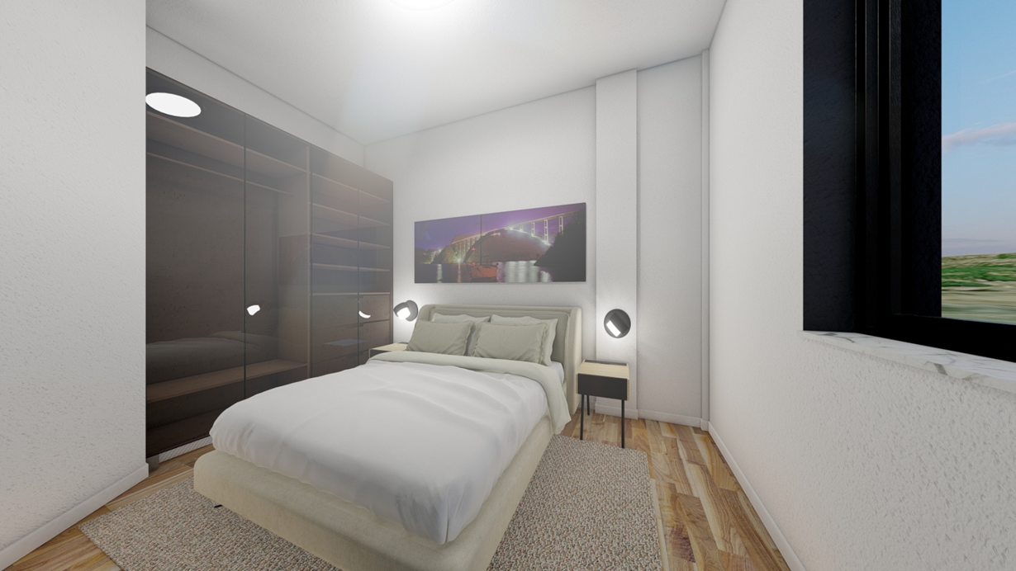
THE UPSTAIRS APARTMENT ROOM

Slide 27
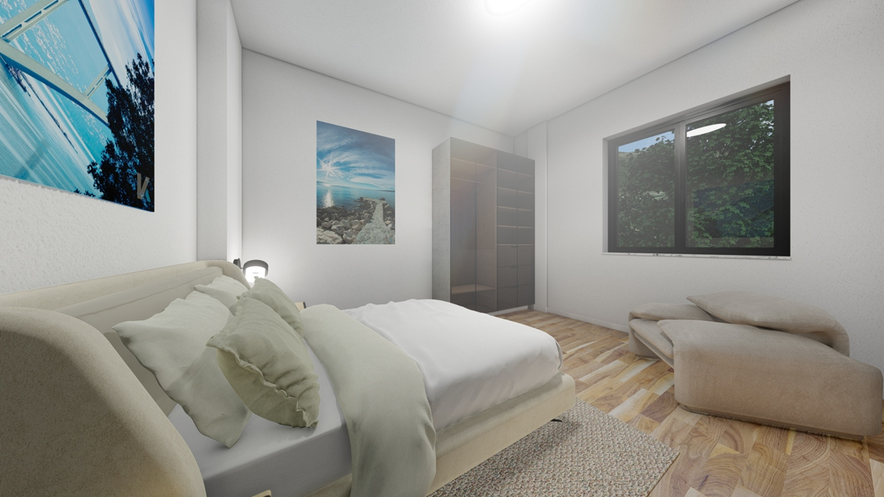
THE UPSTAIRS APARTMENT ROOM

Slide 28

VIEW FROM THE ROAD TO THE BUILDING ENTRANCE AND THE SOUTH-EASTERN FACADE

Slide 29
Estimated construction costs:
The gross area of the building is 800,00 m²
The estimated value of constuction per m² is approx. 900,00 €.
The total value of infrastructure works amounts to 720.000,00 €.

